Slide 1

Reporting
open beds
to OC-OK
Presenters
Dr. Sean Allen
Nicky Rucker
Our Community Our Kids
Paul Epp
Foster Care Technology
Wednesday, 8/12/15, 1:30 PM

Slide 2
Reporting capacity in ECAP
Previously we asked you to report capacity, not open beds
Licensed capacity
Approved capacity
Reporting filled beds
Others in home
Out-of-region children

Slide 3
Reporting capacity in ECAP
Previously we asked you to report capacity, not open beds
Licensed capacity
Approved capacity
Why can’t we just
report open beds?
Reporting filled beds
Others in home
Out-of-region children

Slide 4
Starting August 17
CPA contractors with OC-OK must verify open beds each business day
Identify person(s) in your organization responsible for daily task of verifying open beds
Log into ECAP, pull up open beds report, and click a button to verify the list of opening is accurate
The system logs the daily verification, and OC-OK staff will be able to see the date of last verification

Slide 5

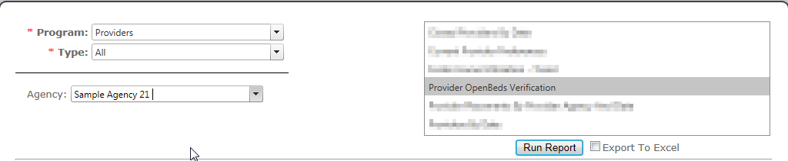
Open Beds Verification Report
In ECAP, click on the “Reports” tab,
choose the
“Provider OpenBeds Verification”
report,
then click “Run Report.”

Slide 6
Open Beds Verification Report
Click here to export open beds
report to Excel.

Slide 7
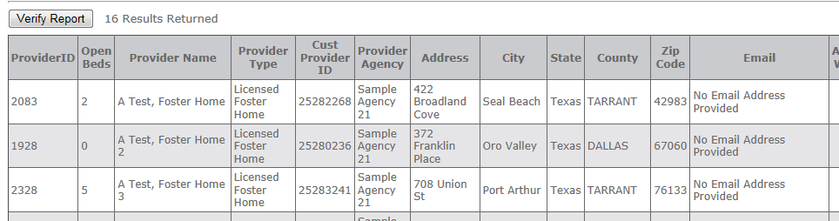
Open Beds Verification Report
Click “Verify Report” to submit your openings to OC-OK each day.

Slide 8
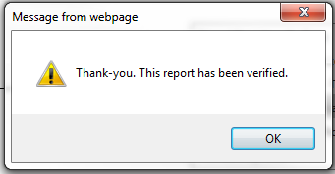
Open Beds Verification Report
ECAP will confirm your verification with the following pop-up.

Slide 9

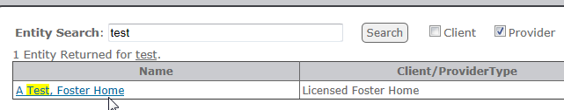
To update open beds in a home
Click the “Search” tab,
type part of the name of the foster home,
and click on the home to pull up its profile.

Slide 10
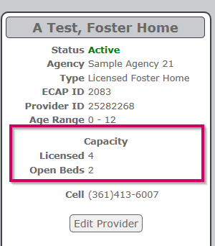

To update open beds in a home
Click “Edit Provider”
to make changes.
Scroll down to “open beds”
and enter the updated number.

Slide 11
What kind of opening?
While you’re updating open beds, also use this opportunity to make sure the preferences are filled in for the home.
Home preferences – fill them in.
What types of children is this home prepared to take?
Use “Will Not Take” sparingly.

Slide 12
What if we use PIX to upload
data to ECAP?
Starting August 17
“Open beds” field will be required
“Non-3b” field will no longer be used by OC-OK
Your organization should still log into ECAP to verify your openings.
For PIX-related help: Jordan.Amerman@fiveptg.com

Slide 13
Managing logins
Role of technical contact
Request user accounts via support@oc-ok.org
Request deactivation of accounts as staff turnover.
Serve as point of contact for the organizations for issues related to ECAP, Evolv, and PIX.

Slide 14



Questions and Answers
Use chat feature to submit questions
Help us get the word out
about reporting open beds!

