Slide 1
Overview of Project Management
& Lean Six Sigma
QPI Steering Committee Meeting
December 17, 2015
David Olszewski, DM
Sr. Director of Industrial Engineering – Children’s Health
Adjunct Faculty, Industrial Engineering – UT Arlington

Slide 2
Project Management Defined
A project is a temporary endeavor undertaken to deliver a unique product, service or result.
Management is an administrative discipline designed to plan, execute and control targeted outcomes for an organization.
Thus, Project Management is the application of best known administrative practices that result in the fulfillment of scope, schedule and budget with regard to a temporary endeavor.
Project managers use many tools like: project charters, business requirement documents, change requests, project schedules, RACIs, communication plans, logs for issues, risks and decisions, etc.
Initiation
Planning
Execution
Closing

Slide 3
Initiation Phase
Create Project Summary with Sponsor
  Why: Project goals and business drivers
  What: Scope and objectives, known deliverables, desired end date
  Who: Project participants, roles and responsibilities
  Verify sponsor’s role and escalation path
Define Project Scope with Stakeholders
  System impacts
  Boundaries, constraints/dependencies, assumption and items out of scope
  Risks and mitigation plans
  Milestones and Accomplishments
Templates
  Initiation phase checklist/ FAQs
  Project charter: Word/Excel using SMART goals

Slide 4
Planning Phase
Create Project Plan and Secure Team Commitment
  Engage team members
  Conduct kick-off meeting
  Verify communication methods
  Plan tasks and due date
  Assign tasks and secure commitments
  Create budget estimates
  Update charter, obtain sponsor approval on charter and project plan
Templates
  Planning phase checklist
  Kick-off meeting agenda
  Project plan: Word/Excel
  Project plan – Advanced version with Gantt chart
  Planning phase FAQs

Slide 5

Execution Phase
Reconfirm Plan and Collect Information
  Reconfirm the plan at predefined milestones
  Collect information regularly
  Standard updates
  Project variance
Take Corrective Action Immediately
  Manage risks and issues
  Manage cost, schedule, and resource variances
  Control change and scope creep
  Manage team dynamics
It keeps growing and
it never ends

Slide 6
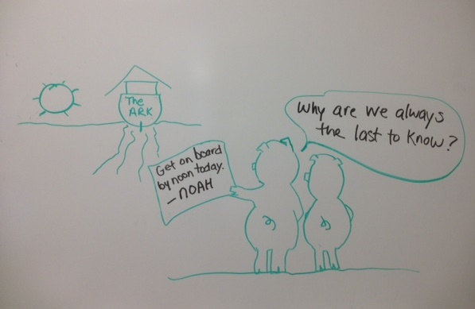
Execution Phase cont.
Keep People Informed
  Written reports
  Formal leadership update meetings
  Regular team meetings
  Obtain sponsor sign-off at the completion of each milestone
Templates
  Executive phase checklist
  Team meeting agenda
  Executive summary report
  Leadership meeting prep guide
  Project decision log
  Change request template

Slide 7
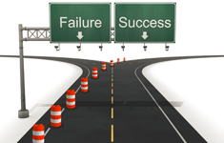
Closing Phase
Close the Project
  Obtain sponsor’s final approval
  Capture lessons learned
  Distribute lessons learned
  Celebrate project completion
  Communicate project success
Templates
  Closing phase checklist
  Lessons learned log: Word/Excel
  Lessons learned survey
  Customer acceptance form

Slide 8

What is Lean?
“Lean” is the set of management practices based on the Toyota Production System (TPS) developed in the 1940s.
The goals of Lean are pretty consistent across industries — to simultaneously improve: Safety, Quality, Delivery, Cost and Morale.
  Eliminate waste and non-value-added activity (NVA) through continuous improvement
The opposite of waste is value-added (VA) activities that the customer is willing to pay for, think of “value” in a patient care process to involve:
  Comforting the patient
  Examining them
  Diagnosing them
  Treating them
  Educating them
  Preventing future illness

Slide 9
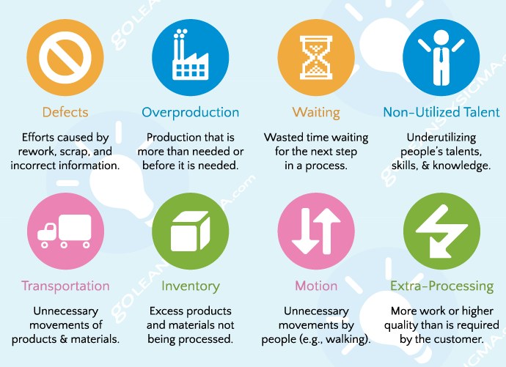
The 8 Types of Waste: DOWNTIME
Waste (Muda): Activities that use resources, but add no value to the finished product or service

Slide 10
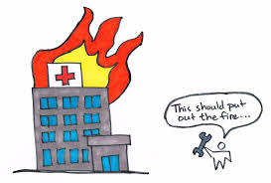
Lean Tools
There are a number of tools within the Lean toolkit you can use to help eliminate waste:
  Visual Controls
  Kaizen Events
  Daily Accountability
  Waste Walks (Gemba)
  6S
  Cellular Flow
  Total Productive Maintenance
  Leader Standard Work
  Value Stream Mapping
  FMEA
  Poke Yoke
  Kanban
  One-Piece Flow Production
  Heijunka/ Workload Leveling

Slide 11
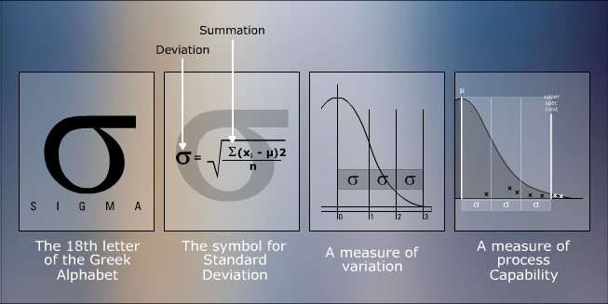
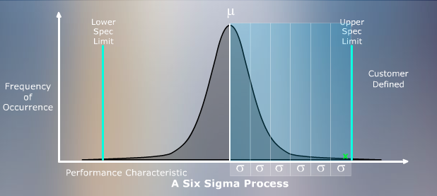
What is Six Sigma?
The term “Six Sigma” is based on a statistical concept: Defects can be minimized by maintaining 6 standard deviations between the process mean and its upper & lower specification limits.
Sigma Level | DPMO | % Conformance | % Failure
2 | 308,357 | 69% | 31%
3 | 66,807 | 93% | 7%
4 | 6,210 | 99% | 1%
5 | 233 | 99.98% | 0.02%
6 | 3.4 | 99.9996% | 0.0004%

Slide 12







Where did LEAN & Six Sigma Come From?
  Developed in the 1940s at Toyota
    Toyota Production System (TPS)
      TPS known as Lean in the USA
      1986: Developed at Motorola by Bill Smith & Bob Galvin
      1995: Jack Welch made it central to his business strategy at General Electric
      2002: “Lean Six Sigma: Combining Six Sigma with Lean Speed” book written by Michael George

Slide 13
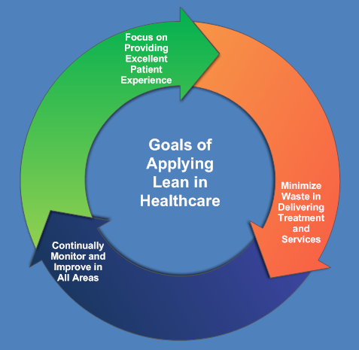
What is Lean Six Sigma? (LSS)
Streamlining processes by eliminating waste
- Customer driven
- Process-centric
- Error/mistake-proofing
- Continuous monitoring & improvement in ALL areas!
Improving quality by minimizing variations and defects/errors
- Measuring defects per million opportunities (DPMO)
- Customer driven
- Process-centric
- Continuous monitoring & improvement in ALL areas!
Highly effective way to
improve processes!

Slide 14
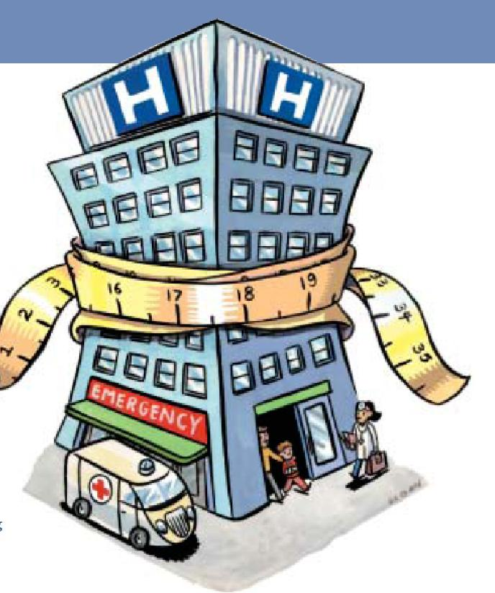
Why Do Healthcare Organizations Use LSS?
Avoid unnecessary expenses
Reduce overtime
Achieve cost savings
Shorten wait times
Speed up patient care
Improve accuracy
See patients more quickly
Reduce surgical patient wait time
Lower appointment cancellations/no-shows

Slide 15
The LSS Roles & Responsibilities
Role | Responsibilities
Champion | Ensures project resources needed are available Runs interference when the team encounters barriers, roadblocks Facilitates collaboration across the organization
Sponsor | Supports the project’s day-to-day activities/responsibilities Works closely with the BB &/or GB
Yellow Belt (YB) | DMAIC project core team member May be responsible for running smaller projects
Green Belt (GB) | Leads or initiates DMAIC projects, or assists a BB or in a BB project DMAIC resource for her/his organization
Black Belt (BB) | Leads Six Sigma projects (beyond DMAIC) / Leverages GBs & YBs Facilitates understanding/application of tools, techniques, strategies
Master Black Belt (MBB) | Leads strategic initiatives that increase quality maturity Leads &/or supports highly-complex process improvement projects Primarily coaches BBs / renowned for their situational handling & leadership

Slide 16

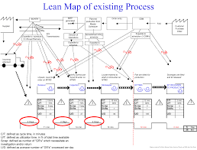
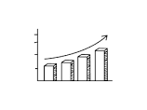


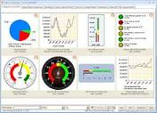
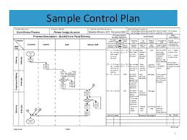
The DMAIC Roadmap
Purpose Key Questions
Key Tools Deliverables
Define the problem
(aka Develop the
project charter)
Baseline the current process performance
Identify the root causes to be addressed
Validate solutions to improve process performance
Implement controls to maintain the gains
- Who is our customer?
- What are we trying to improve and by how much?
- What is the scope of the project?
- What is the current cost of not meeting performance targets?
- What is the estimated financial impact after solution implementation?
Project Charter
SIPOC
Stakeholder Matrix
RASCI / Project Plan
Communication Plan
Project Charter
~~~~~~~~
~~~~~~~~
~~~~~~~~~
Approved Project Charter
High Level Process Map
Stakeholder Analysis
Storyboard
Data Collection Plan
Detailed Process Map
Measurement Systems Analysis
Current Process Performance Analysis
Revised Storyboard
Cause & Effect Analysis
Validated, Selected & Prioritized Root Causes
Proposed Action / Improvement Plan
Revised Storyboard
Decision-Making Process Results
Pilot Results vs. Complete Roll-Out
New-Reality Process Map (‘To Be’)
Risk Assessment Results on Improved Process
Proposed Control Plan
Revised Storyboard
Improved Process Performance Analysis Results
Metrics Integration Results
Implementation Results
Control Plans
ID Next Improvement Opportunity
Define
- What is the data collection plan?
- Is our measurement system adequate
(Can we trust the data?)
- What is the current process flow and performance?
- When does the problem occur?
- Where does the problem occur?
- Which roles are involved when the problem occurs?
Data Collection Plan
Measurement System Analysis (Gage R&R)
Detailed Process Map / Value Stream Map
Graphical Analysis (Pareto)
RASCI / Project Plan
Measure
- How many cause categories contribute towards the identified effect?
- How do the causes affect process output? What’s the extent of their reach or influence?
- Which root causes will we address? In which order?
Fishbone Diagram (5-Whys)
Affinity Diagram
Cause & Effect Matrix
Hypothesis Development & Test
Process / Graphical Analysis
Future Reality Process Map
RASCI / Project Plan
Analyze
- What are the expected value-adds & benefits?
- What actions are in place to mitigate identified risks?
- Were the implemented solutions successful in addressing the root causes?
- What is the new process performance?
Benefit & Effort Matrix
Weighted Criteria Matrix
Improvement / Action Plan(s)
Risk Assessment (FMEA)
Pilot Plan
Future Reality Process Map
Process / Graphical Analysis
RASCI / Project Plan
Improve
FMEA
~~~~~
- Did we accomplish our goal(s)?
- What were the final results? Where did our results meet, exceed or fall short?
- Are Control Plans in place to assure the improved process is sustainable? Who is responsible?
- Where else can the learning from this DMAIC project be applied?
Process / Graphical Analysis
Metrics Dashboard Integration
Control Plans
RASCI / Transition Plan
Final Project Documentation
Control

Slide 17
DMAIC Roadmap: Define Phase
Purpose | Key Questions | Key Tools | Deliverables
Define the problem (aka Develop the project charter) | - Who is our customer? - What are we trying to improve and by how much? - What is the scope of the project? - What is the current cost of not meeting performance targets? - What is the estimated financial impact after solution implementation? |  | Approved Project Charter High Level Process Map (SIPOC) VOC Feedback
- Project Charter
SIPOC
VOC

Slide 18
DMAIC Roadmap: Define Phase
Project Charter
Problem Statement:
The problem statement is a clear and concise statement that describes the symptoms of the problem to be addressed. It does not suggest solutions. The problem statement should include:
WHAT is wrong (e.g., solution doesn’t meet customer needs; defects reported)?
HOW do you know it’s a problem (e.g., SLAs/specs confirm non-compliance)?
DURATION: for how long has it been a problem?
WHY it is a problem (e.g., release [code] can’t be deployed as scheduled)?
Name | Role
X | Champion
X | Sponsor
X | Yellow Belt (YB)
X | Green Belt (GB)
X | Black Belt (BB)
X | SMEs – other roles (add as needed)
Business Case:
What are the compelling business reasons for embarking on this project or work effort? How does it link to key business/organizational goals and objectives? What will be the benefits to the business/organization in resolving this problem? What will be the negative impacts of not resolving the problem? (If financial positive &/or negative impacts are known – past &/or projected, please include here.)
Strategic Initiative | (should tie to dept./area goal)
Benefit Type | (Reduce cycle time, reduce costs, increase capacity or productivity, risk mitigation, etc.)
Goal Statement:
What is the goal when the problem is resolved? Think of how will the project/work effort key stakeholders and impacted organizations will measure success for this project or work effort.
Scope:
In-scope and out-of-scope items must be stated concisely and explicitly (e.g., what is in & out of scope? Or if process-centric, where does the process start and end? Focus should be on what is needed to reach a solution to the problem.
DMAIC Phase | Planned Tollgate Dates | Actual Tollgate Dates | Status
Define |  |  | In Progress
Measure |  |  | Planned
Analyze |  |  | Planned
Improve |  |  | Planned
Control |  |  | Planned
Risks, Constraints, Assumptions:
Risks: An evaluation of the risk(s) and its associated impact(s).
Constraints: A limitation, either internal or external to the project/work effort, that will affect the performance of the project or work effort.
Assumptions: Factors that, for planning purposes, are considered to be true, real, or certain without proof or demonstration (e.g., you will be fully supported by your Champion and Sponsor on this project/work effort until you reach your goal).

Slide 19
DMAIC Roadmap: Define Phase
SIPOC Diagram

Slide 20
DMAIC Roadmap: Define Phase
RASCI Matrix

Slide 21
DMAIC Roadmap: Measure Phase
Purpose | Key Questions | Key Tools | Deliverables
Baseline current process performance | - What is the data collection plan? - Is our measurement system adequate (Can we trust the data?) - What is the current process flow and performance? - When does the problem occur? - Where does the problem occur? - Which roles are involved when the problem occurs? |  | Data Collection Plan Process Map Spaghetti Diagram Current Process Performance Analysis
- Data Collection Plan
- Process Map
- Spaghetti Diagram

Slide 22
DMAIC Roadmap: Measure Phase
Pareto Analysis
Surgical Setup Errors by Type
80/20 rule: 80% of problems are caused by 20% of causes

Slide 23
DMAIC Roadmap: Analyze Phase
Purpose | Key Questions | Key Tools | Deliverables
Identify the root causes to be addressed | - How many cause categories contribute towards the identified effect? - How do the causes affect process output? What’s the extent of their reach or influence? - Which root causes will we address? In which order? |  | Cause & Effect Analysis Validated, Selected & Prioritized Root Causes Proposed Action / Improvement Plan
- Fishbone Diagram (5-Whys)
- Cause & Effect Matrix
- Pareto Chart

Slide 24
DMAIC Roadmap: Analyze Phase
Fishbone Diagram
The Fishbone (aka Ishikawa Diagram)

Slide 25
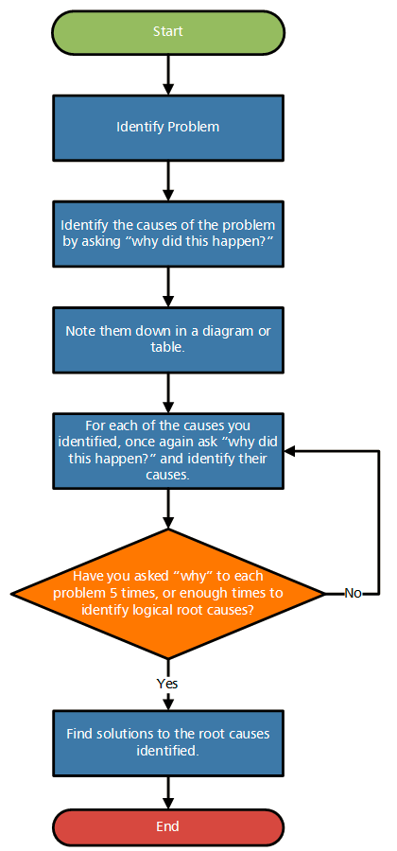
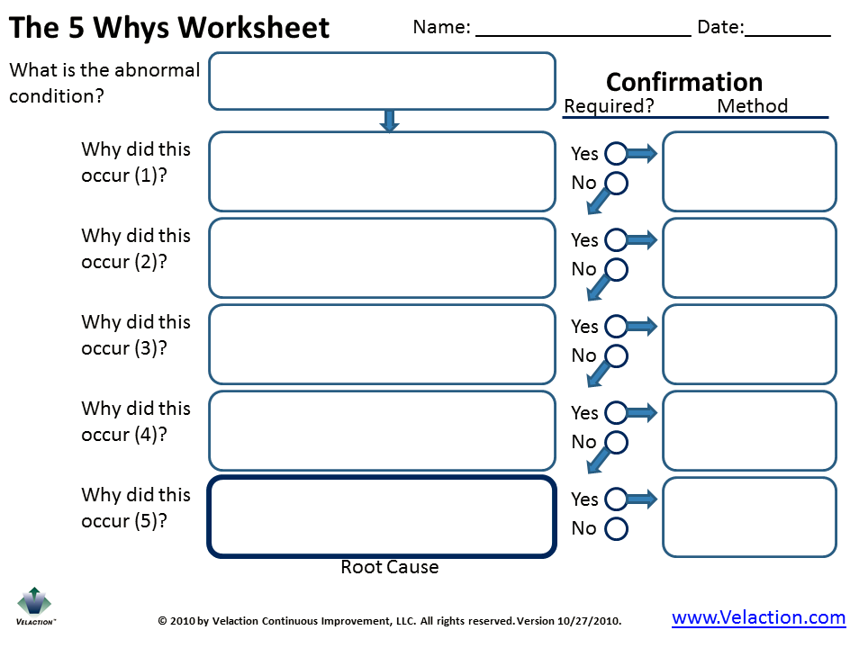
DMAIC Roadmap: Analyze Phase
5 Why Technique
The 5-Why analysis method is used to move past symptoms and understand the root cause.
It is said that only by asking "Why?" five times, successively, can you delve into a problem deeply enough to understand the ultimate root cause.
This methodology can be used to complement the analysis necessary to complete a fishbone diagram.

Slide 26
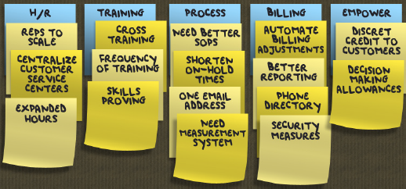
DMAIC Roadmap: Analyze Phase
Affinity Diagram
The Affinity Diagram tool is used to consolidate a large amount of information into groupings or clusters of ideas that have a natural 'affinity', i.e., that have a common thread running through them.
The affinitizing process is best performed by bringing all the team members or stakeholders involved into a room and allowing them to post sticky notes with single ideas on a board or flipchart.
Next, everyone gets together and silently move the notes around into related groups. Not being allowed to talk discourages arguments and justifications.

Slide 27
DMAIC Roadmap: Improve Phase
Purpose | Key Questions | Key Tools | Deliverables
Validate solutions to improve process performance | - What are the expected value-adds & benefits? - What actions are in place to mitigate identified risks? - Were the implemented solutions successful in addressing the root causes? - What is the new process performance? |  | Pilot Results vs. Complete Roll-Out (part of your Improvement-Action Plan) Risk Assessment Results on Improved Process (FMEA) Proposed Control Plan
- Improvement / Action Plan
- Failure Mode & Effect Analysis (FMEA)
- 6S
- Run Chart

Slide 28
DMAIC Roadmap: Improve Phase
Improvement/ Action Plan
Allows your team to capture the planned Actions & Improvements in the short and long-term

Slide 29
DMAIC Roadmap: Control Phase
Purpose | Key Questions | Key Tools | Deliverables
Implement controls to maintain the gains | - Did we accomplish our goal(s)? - What were the final results? Where did our results meet, exceed or fall short? - Are Control Plans in place to assure the improved process is sustainable? Who is responsible? - Where else can the learning from this DMAIC project be applied? |  | Improved Process Performance Analysis Results Metrics Integration Results Implementation Results Control Plan ID Next Improvement Opportunity
- Control Plan
- Run Chart

Slide 30
DMAIC Roadmap: Control Phase
Process Control Plan

Slide 31

Key Takeaways/ Questions?
Project Management is the application of best known administrative practices that result in the fulfillment of scope, schedule and budget with regard to a temporary endeavor.
Lean Six Sigma (LSS) methodology combines the Lean philosophy & Six Sigma method/ tools to reduce waste and process variation.
Define, Measure, Analyze, Design and Verify (DMADV) can be used in place of DMAIC when creating new process/ workflow.
Any Questions?

