Slide 1

Tech Timeline

Slide 2
Start-Up Months
Jan - Feb: Information gathering
March - June: Building infrastructure

Slide 3
We heard you.
Standardize data requirements
with Providence
Automate data uploads from your agency software

Slide 4

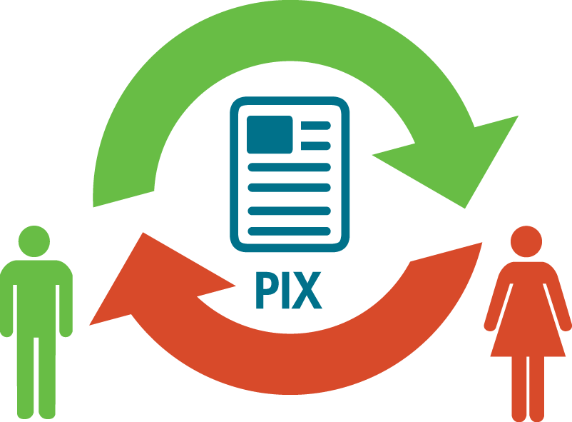
JUNE
1
PROVIDER ACTIVITY
ECAP Training &
Begin data entry
or
DEADLINE TO DECLARE METHOD OF DATA SUBMISSION
Prepare for
Provider Information
Exchange (PIX)

Slide 5


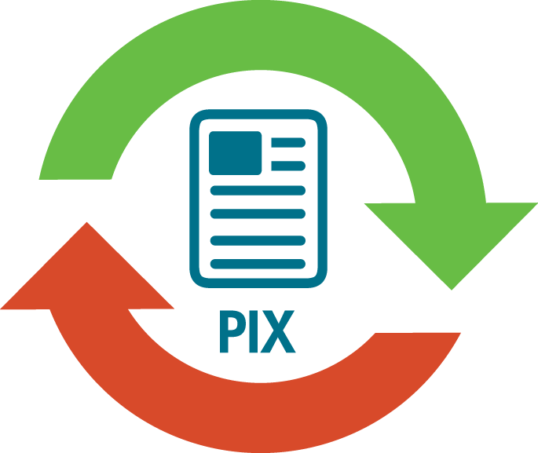
JULY
1
PROVIDER ACTIVITY
Maintain home data in ECAP
or
FIRST WAVE OF LEGACY TRANSFER: ACH CLIENTS BEGIN TO TRANSFER
Upload home data to PIX

Slide 6
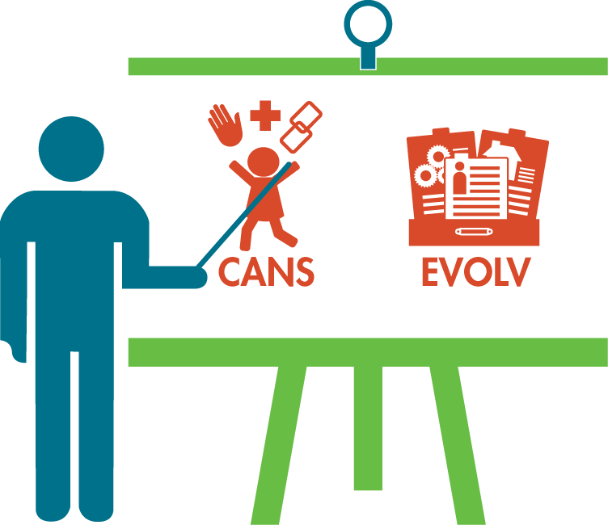
AUGUST
SECOND WAVE OF LEGACY TRANSFER (NEXT ORGANIZATION)
PROVIDER ACTIVITY
CANS Training
Evolv Training

Slide 7

SEPTEMBER
1
PROVIDER ACTIVITY
Begin entering data in Evolv
or
NEW REFERRALS BEGIN
Begin uploading child data to PIX

Slide 8

More info
oc-ok.org
fiveptg.com
Sean Allen
pixtexas.com
sallen@oc-ok.org
(coming soon)

